Slide 1

Prediction Dashboard
6 Asian Guys and a Shilpasian
presents
Jason Chong
Jason Lee
John Ngo
Justin Le
Matt Yee
Michael Lee
Shilpa Khanolkar

Slide 2

Background
With an estimated $95 billion that is placed on sports betting annually, the NFL is the most popular amongst these sports.
In 2018, $158 million was wagered on the Super Bowl.
There is a multitude of statistics for teams, seasons, games, and players out there.
Knowing the key team statistics of a game can be used to help predict the outcome of a game.

Slide 3
The Dashboard
Dashboard Home Page
NFL Scoreboard Ticker
Fantasy Statistics
Prediction Models
Win/Loss Prediction Model
Projected Points Prediction Model
Data Visualizations
How it Works
NFL Twitter Feed

Slide 4
Technologies Used
Machine Learning
Sci-Kit
StatsModels OLS
Keras
Front-End
HTML
CSS
Bootstrap
JavaScript
jQuery
Back-End
Python Flask
Pandas
Web Scraping
Beautiful Soup
Selenium
Data Visualizations
Tableau
Plotly

Slide 5
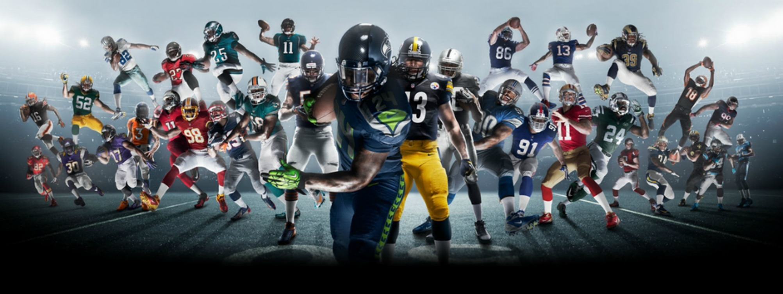
IT’S GAME TIME!
https://six-asians-and-a-shilpasian.herokuapp.com/

